Slide 1

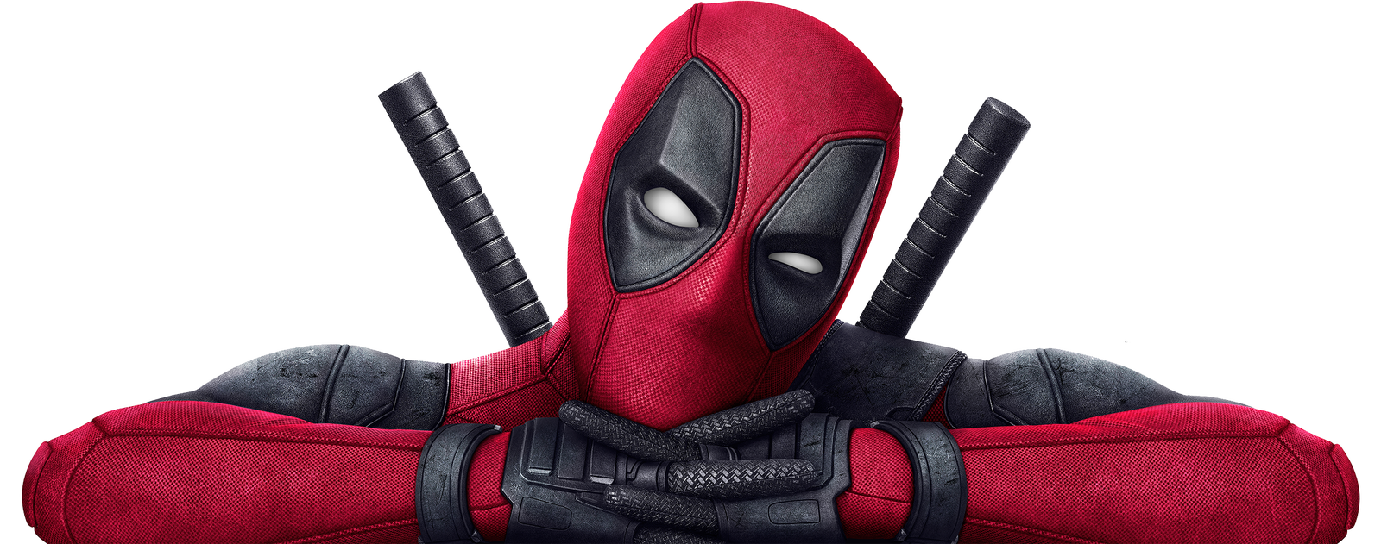

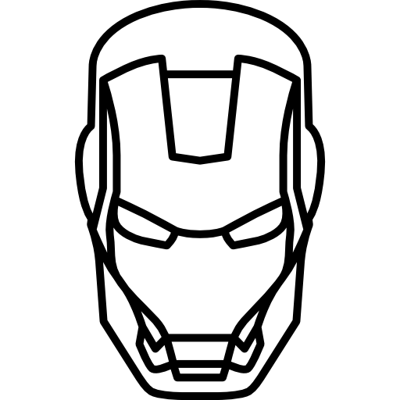
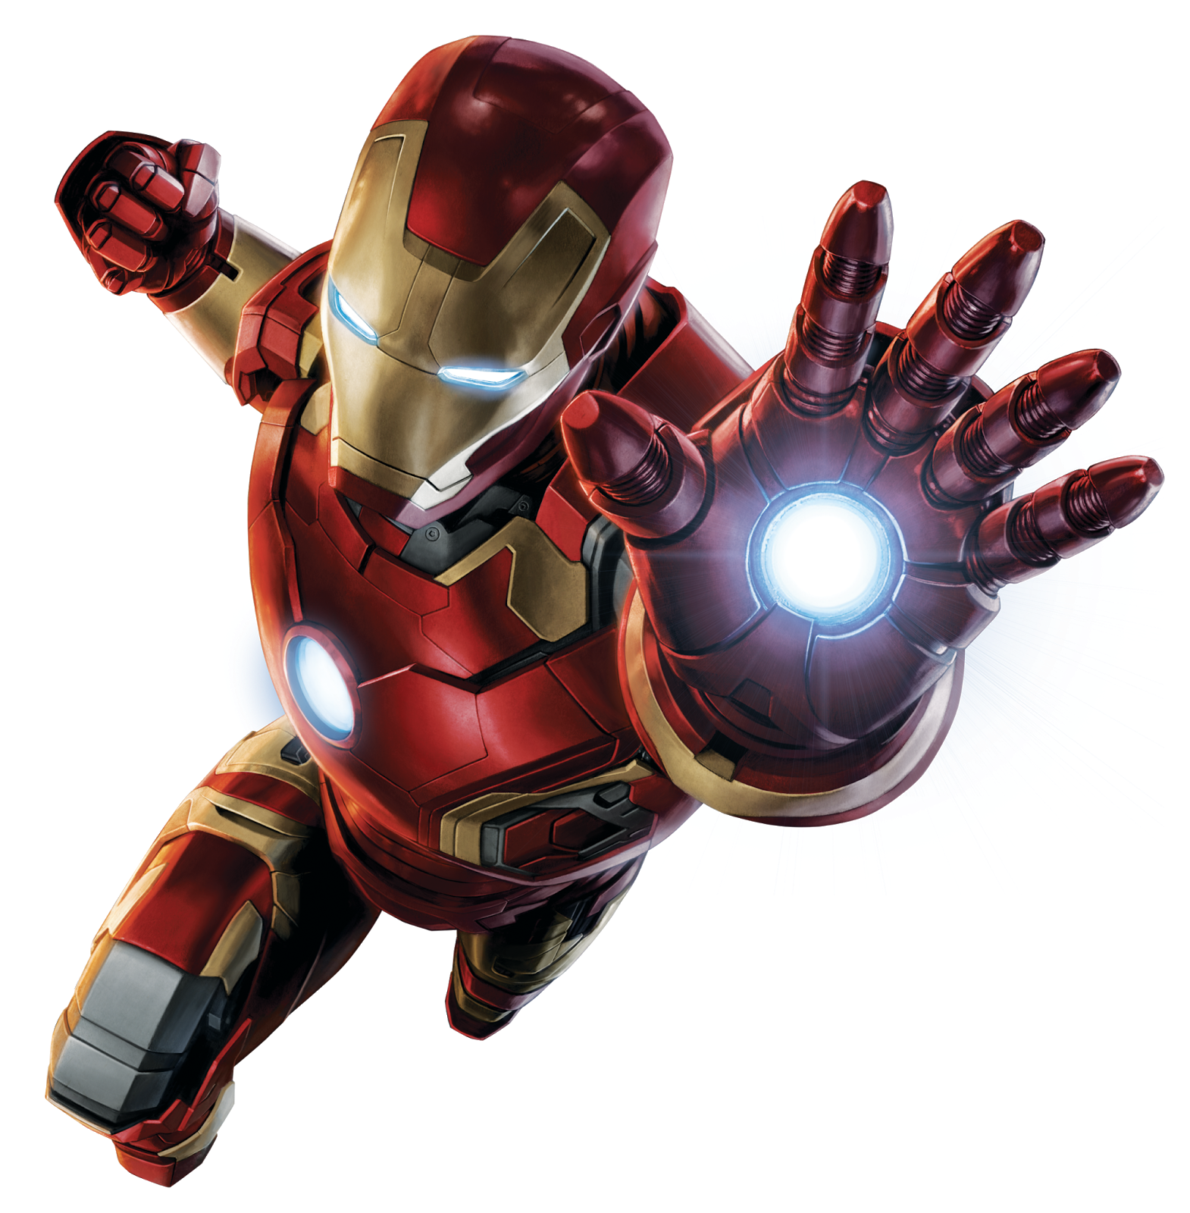
Top 4 MARVEL SUPERHERO REVIEW
IRON MAN
CAPTAIN AMERICA
THOR
SPIDER-MAN
As a dedicated Marvel fan, I am thrilled to share that I have created a PowerPoint report showcasing my passion for the Marvel universe.
One of my personal beliefs is that Spider-Man holds a special place in my heart, even more so than any of my other three heroes.

Slide 2

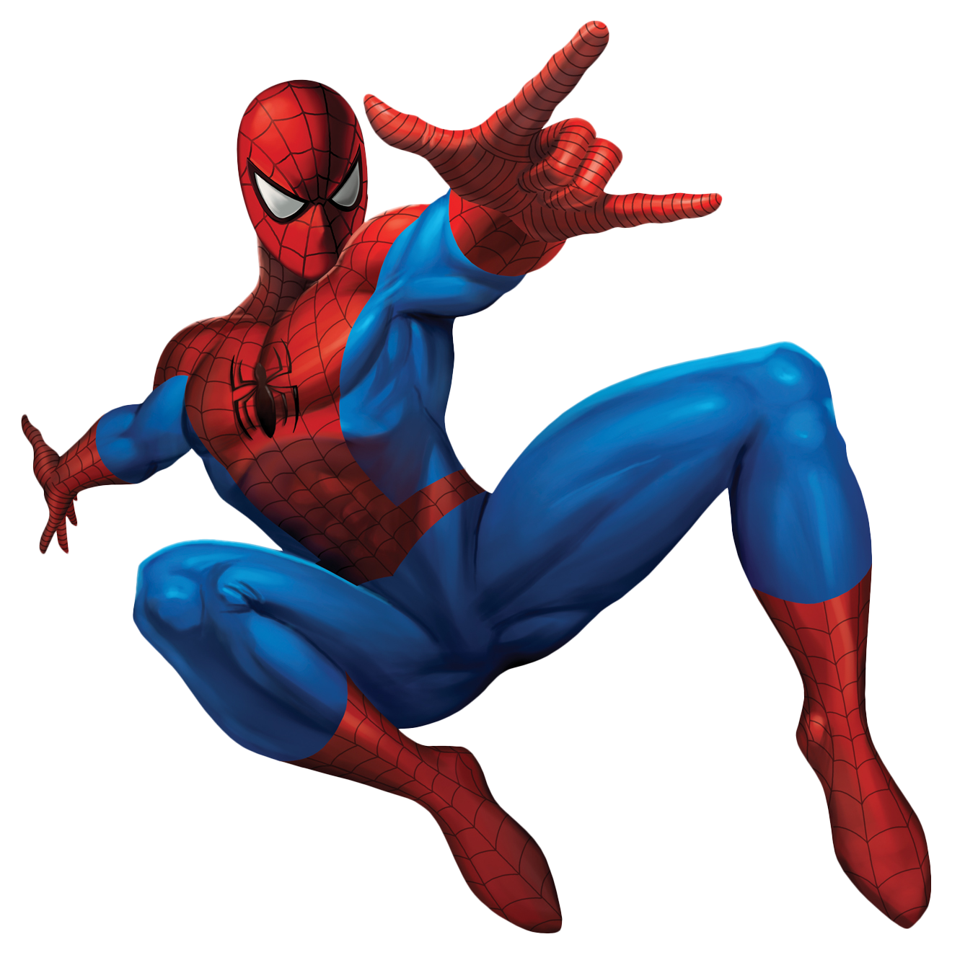
IRON MAN
IRON MAN
Iron Man, played by Robert Downey Jr., stands out in the Marvel Cinematic Universe for his journey from wealthy industrialist to selfless hero.
His reliance on intellect and technology, symbolized by the arc reactor and Iron Man suit, underscores themes of innovation and personal transformation. Tony Stark's evolution from a self-centered arms dealer to a self-sacrificing protector resonates with audiences, highlighting his complex character and enduring appeal.
Strength 6/10
Speed 6/10
Intelligence 6/10
sayanjoy17@gmail.com

Slide 3

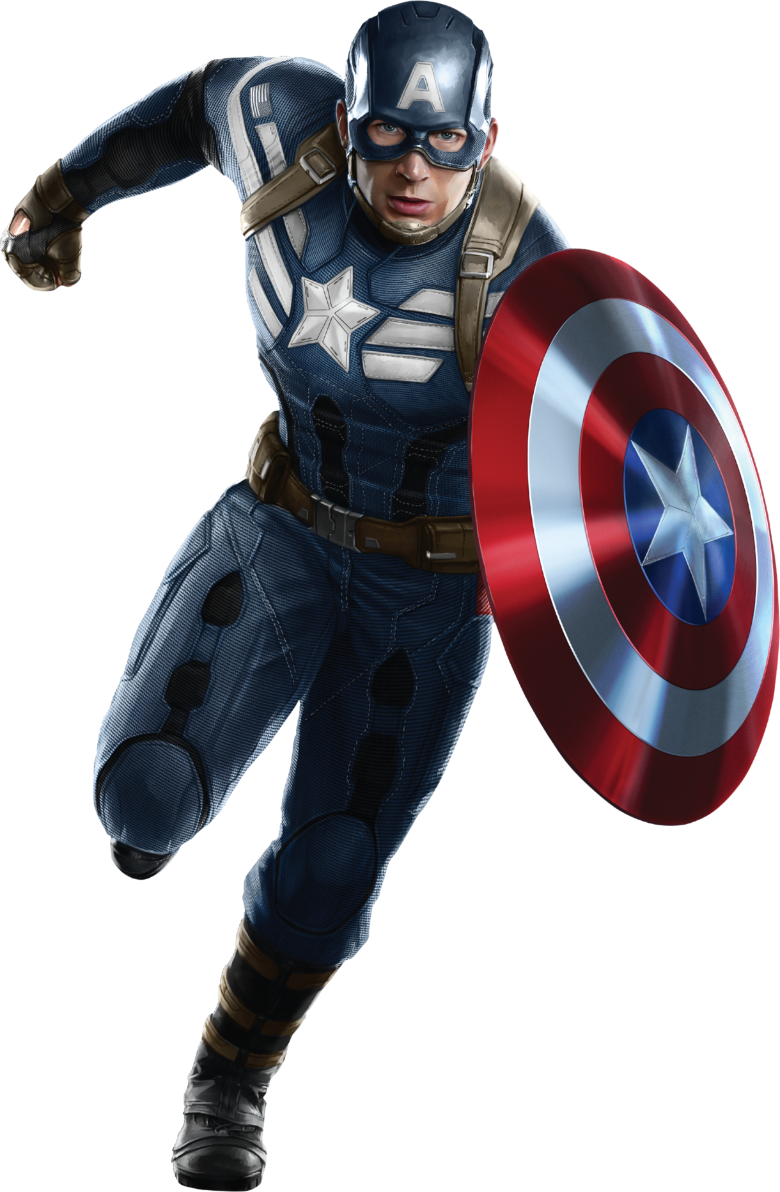
SPIDER MAN
SPIDER MAN
Spider-Man, from Marvel Studios, brings a youthful exuberance and relatability that's hard to match.
His quips and quick wit are as much a part of his superhero persona as his web-slinging abilities. He adds a fresh and dynamic energy to the Marvel Cinematic Universe, weaving a web of humor and heroism that fans love to follow.
Strength 5/10
Speed 5/10
Intelligence 6/10
sayanjoy17@gmail.com

Slide 4
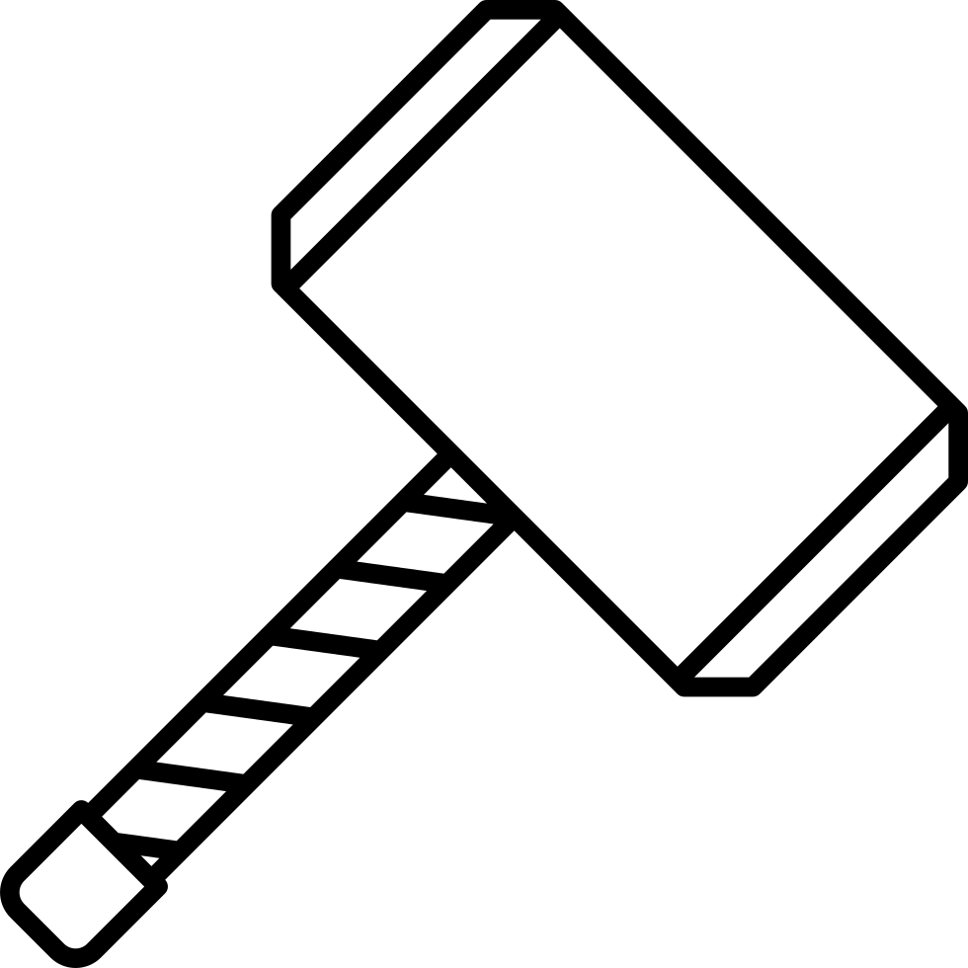
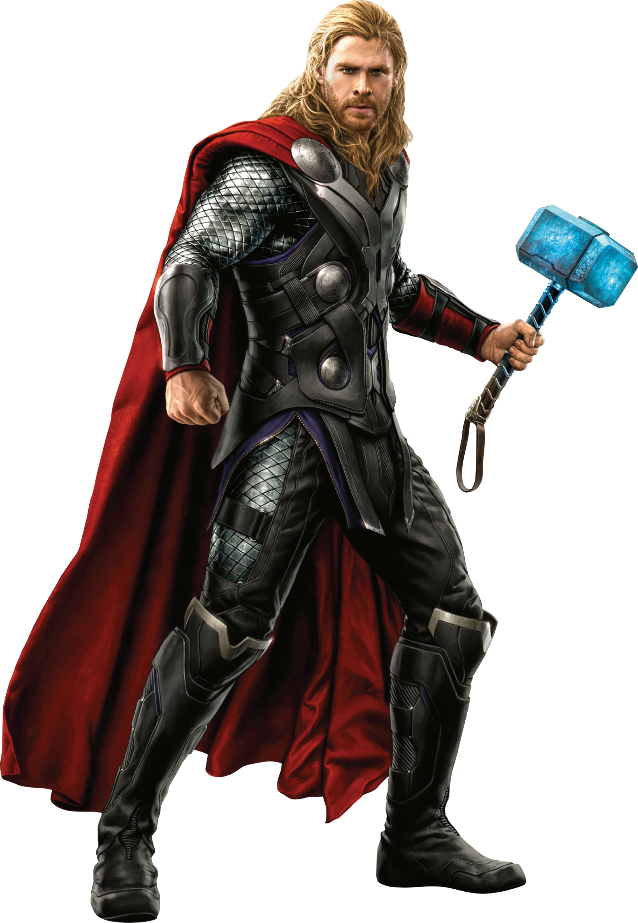
CAPTAIN AMERICA
CAPTAIN AMERICA
Captain America, from Marvel Studios, embodies unwavering dedication to justice and the values of heroism.
His character represents the pinnacle of human potential, forged through courage and integrity. Steve Rogers, transformed from a frail young man into a super-soldier, symbolizes the enduring spirit of resilience and selflessness. His shield, a steadfast emblem of protection and strength, reflects his commitment to defending the innocent and standing against tyranny. Captain America's leadership inspires unity and hope, reminding us that true heroism lies not in power alone, but in the choices we make and the values we uphold.
Strength 5/10
Speed 6/10
Intelligence 6/10
sayanjoy17@gmail.com

Slide 5
Thor Odinson
Thor Odinson
Thor Odinson, portrayed by Chris Hemsworth in Marvel Studios' films, embodies the grandeur of Norse mythology with a modern twist.
His character blends ancient wisdom and heroic valor with a charismatic humor that resonates with audiences. Thor's journey from impulsive warrior to wise leader showcases themes of growth, redemption, and the enduring strength found in both physical prowess and inner resolve.
Strength 5/10
Speed 6/10
Intelligence 6/10
sayanjoy17@gmail.com

Slide 6
So Who Stands Out Among These Four AVENGERS
The Best, the Strongest, and the Strangest
sayanjoy17@gmail.com

Slide 7
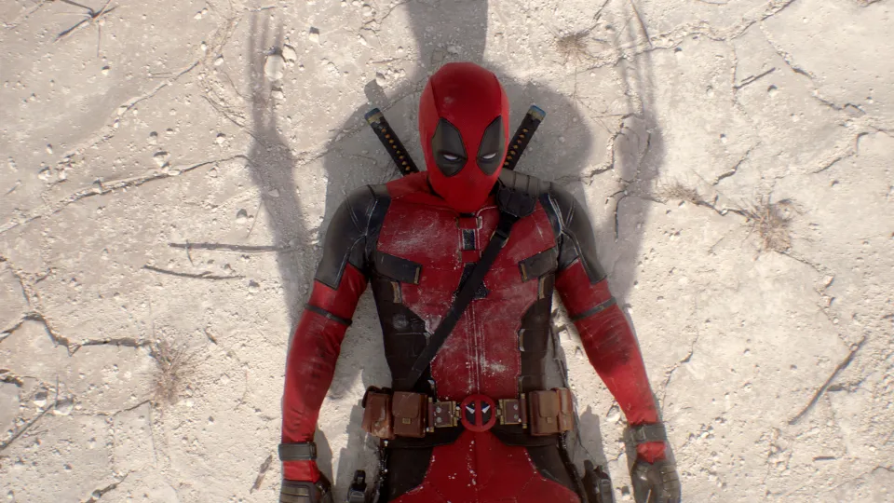
No question, it's obviously Deadpool.
sayanjoy17@gmail.com

